Slide 1
MEC103
ISOMTERIC PROJECTIONS
UNIT-5
School of Computer Science and Engineering
LPU, Phagwara -India.

Slide 2
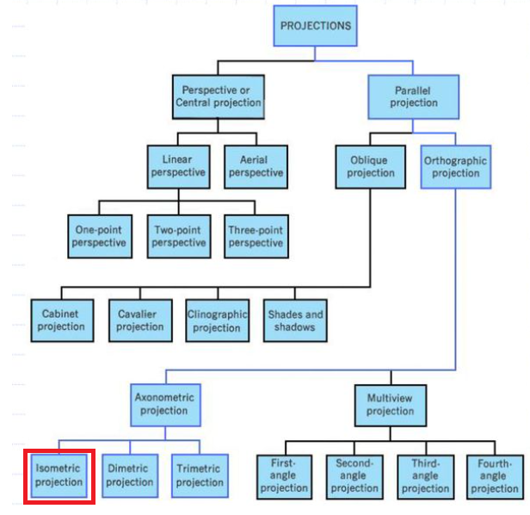
Classification of Projections

Slide 3
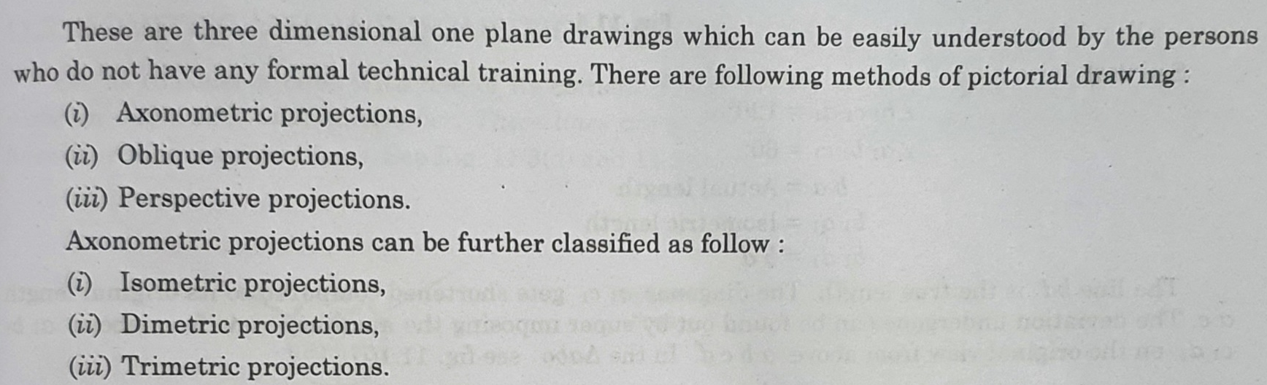
Isometric Projections
Isometric Projections

Slide 4
Axonometric Projections

Slide 5
Axonometric Projections

Slide 6
Axonometric Projections

Slide 7
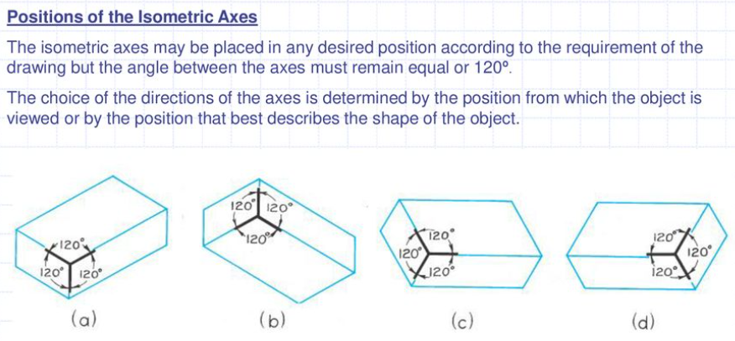
Axonometric Projections

Slide 8
Some important terms

Slide 9
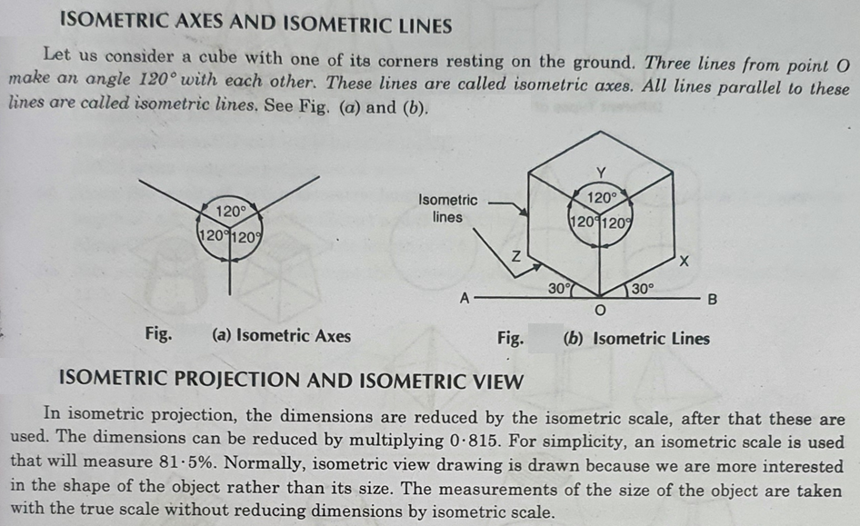

Slide 10
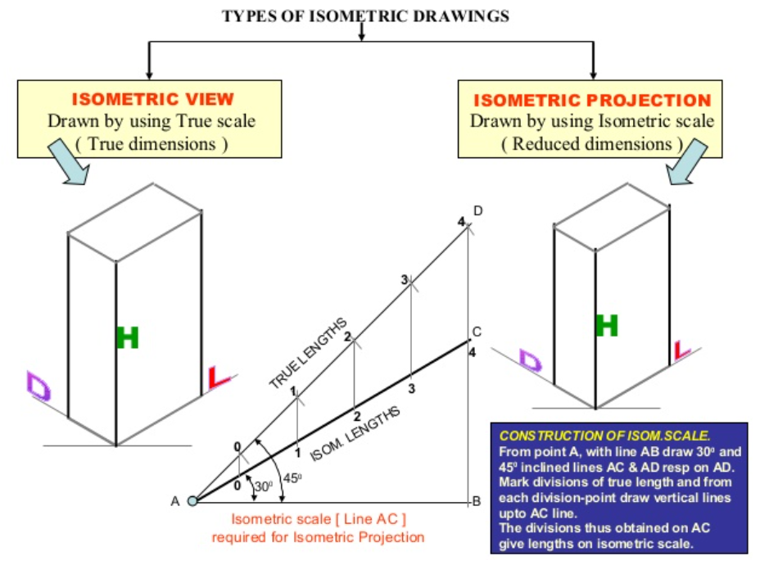
Some important terms

Slide 13
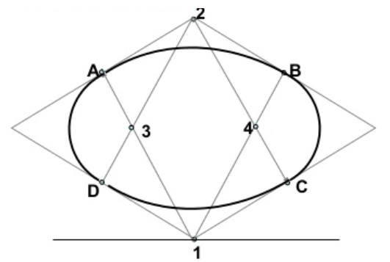
Four centre method

Slide 14
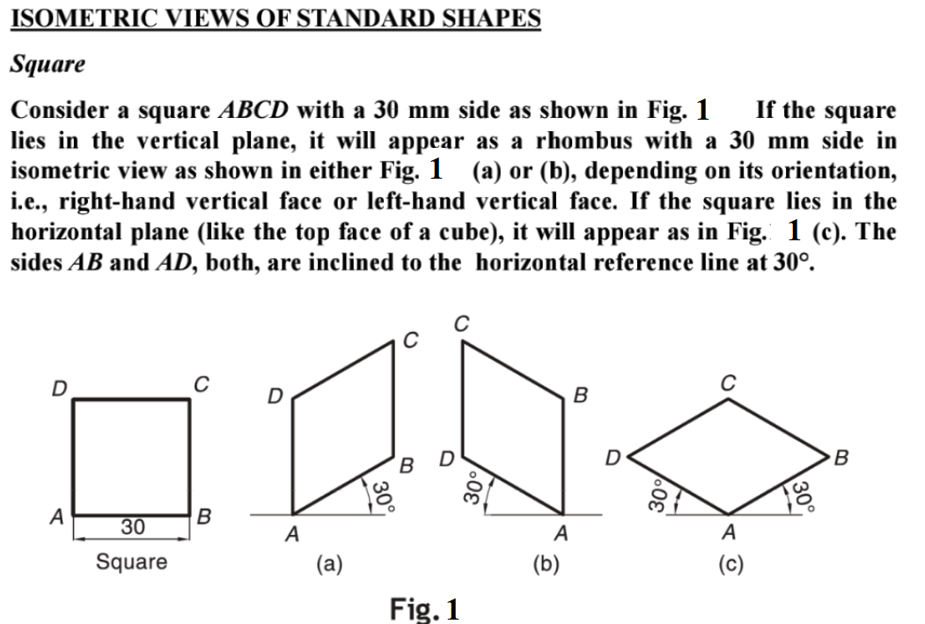
Standard shapes

Slide 15
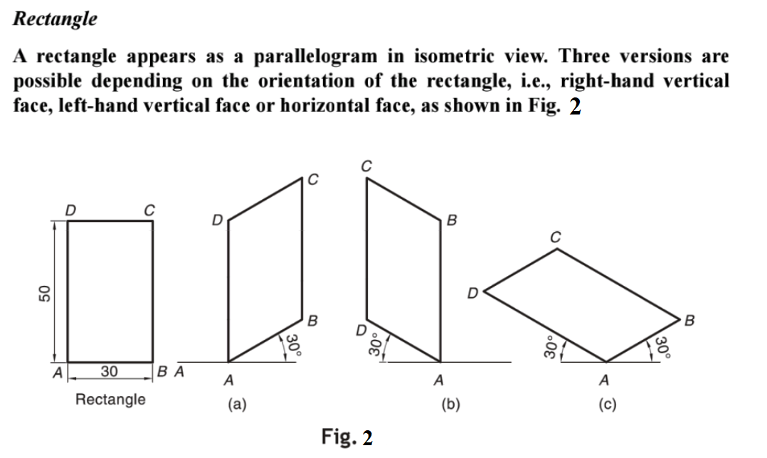
Standard shapes

Slide 16
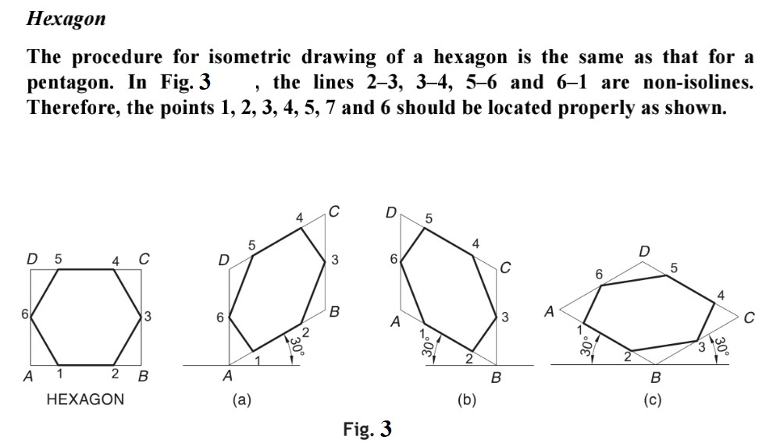
Standard shapes

Slide 17
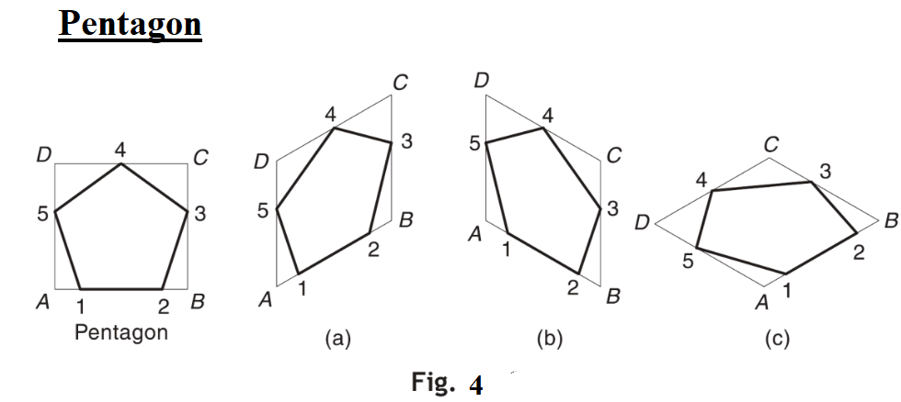
Standard shapes

Slide 18
Hexagonal Prism

Slide 19
Pentagonal Prism

Slide 20
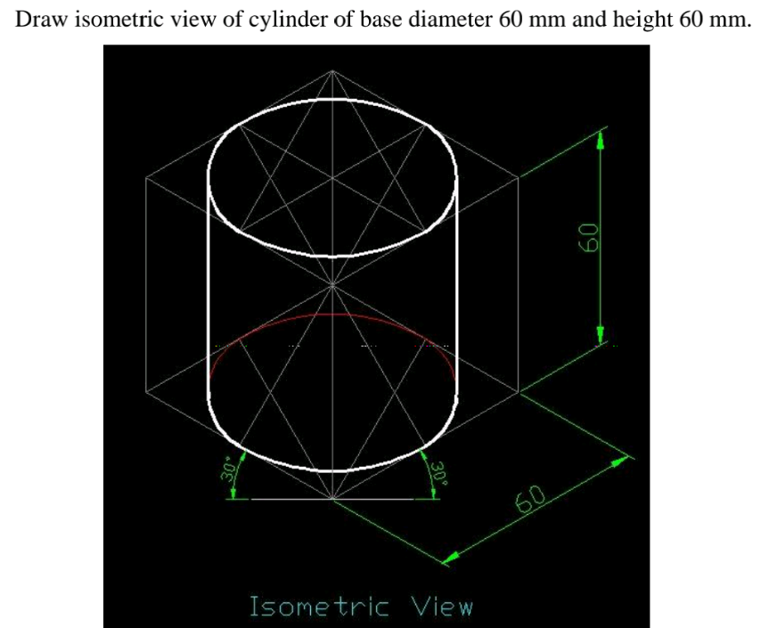
Cylinder

Slide 21
Cone

Slide 22
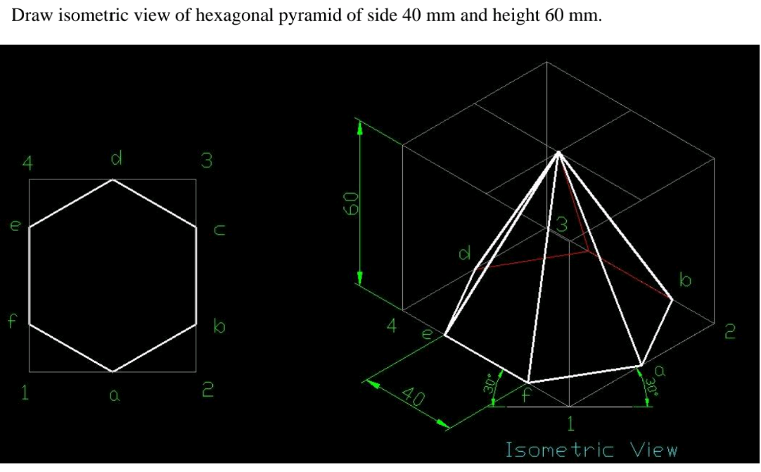
Hexagonal pyramid

Slide 23
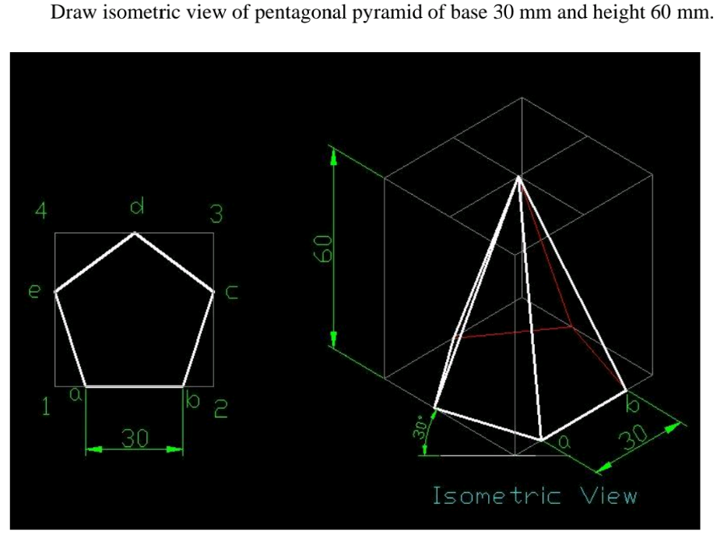
Pentagonal pyramid

Slide 24
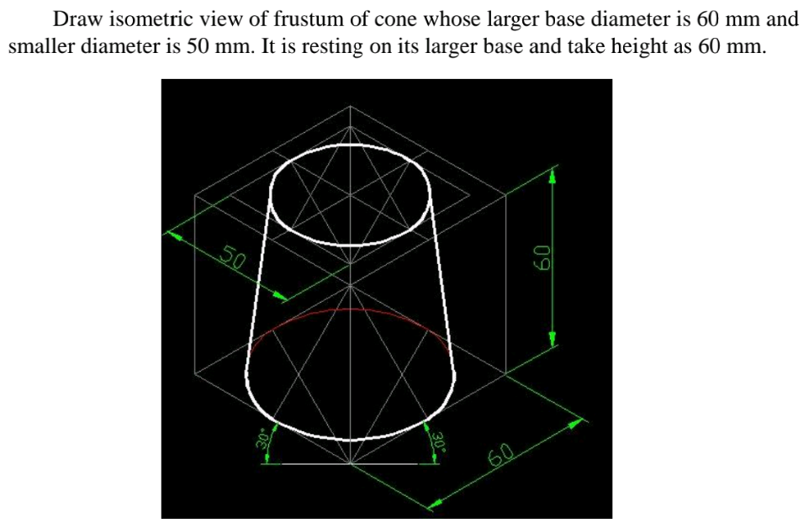
Frustrum of cone

Slide 25
Cone resting on cylinder

Slide 26
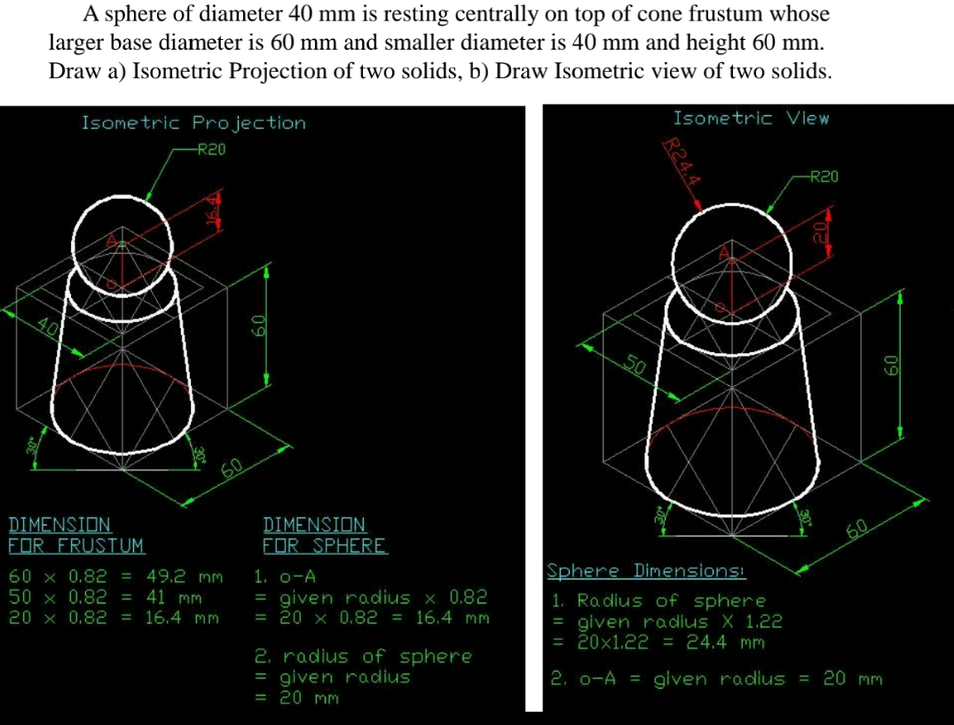
Sphere resting on top of cone frustrum

Slide 27
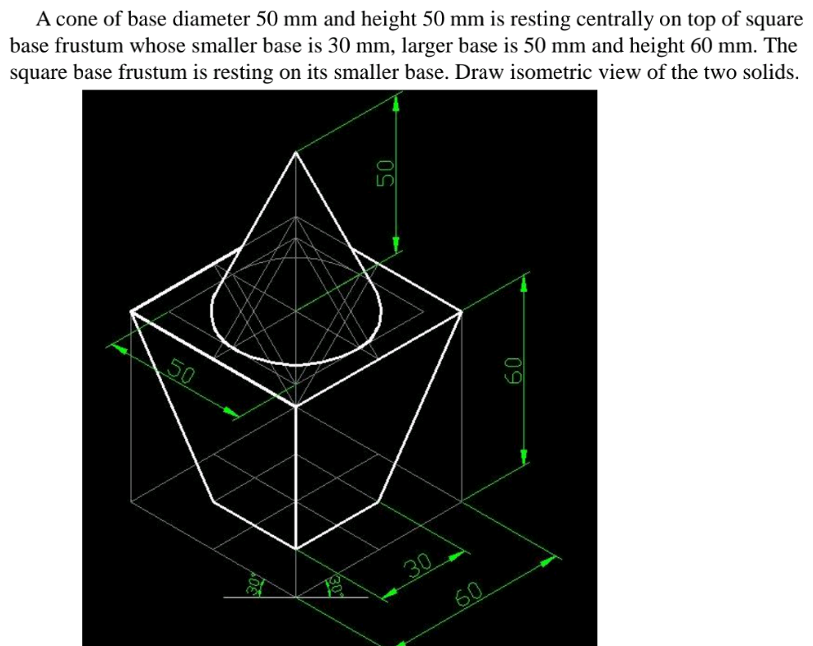
Cone resting on square base frustrum

Slide 28
Square pyramid resting on hexagonal prism

Slide 29
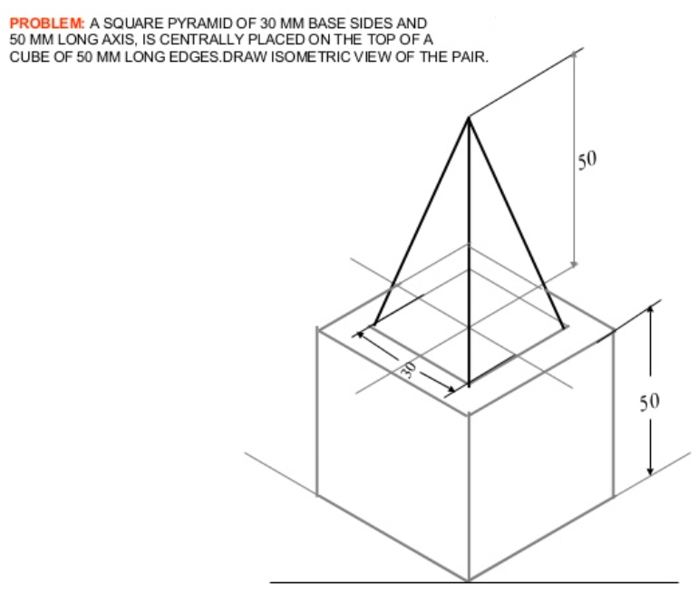
Square pyramid resting on cylinder

Slide 30
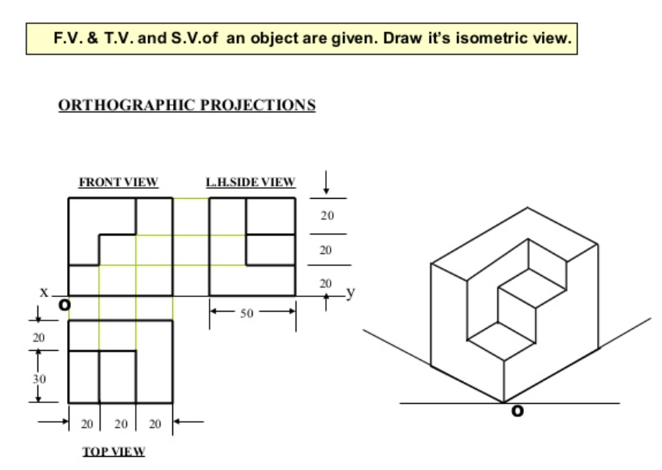

Slide 32
Thanks

